Slide 1
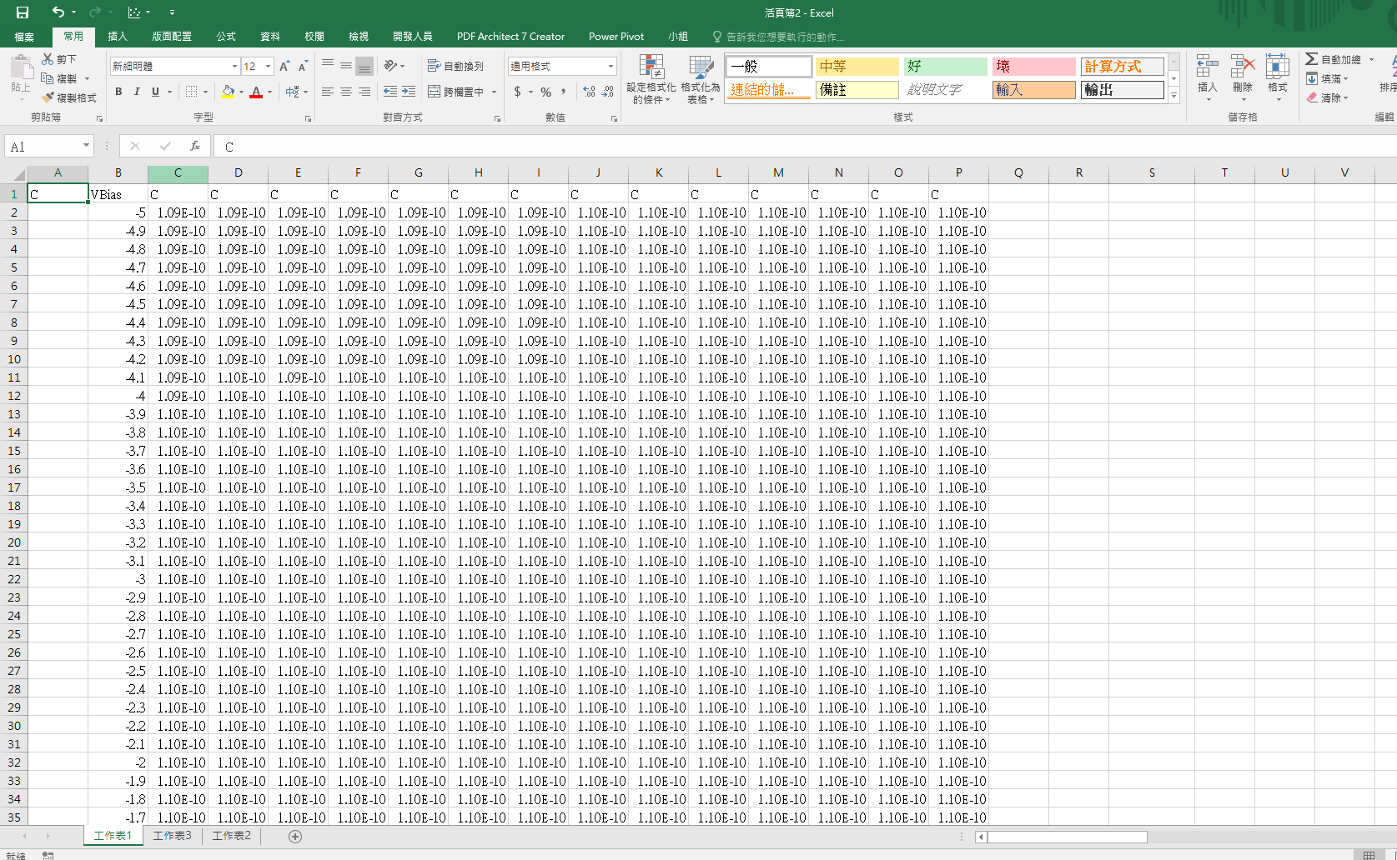
Group 1
Group 2
Group 3

Slide 2
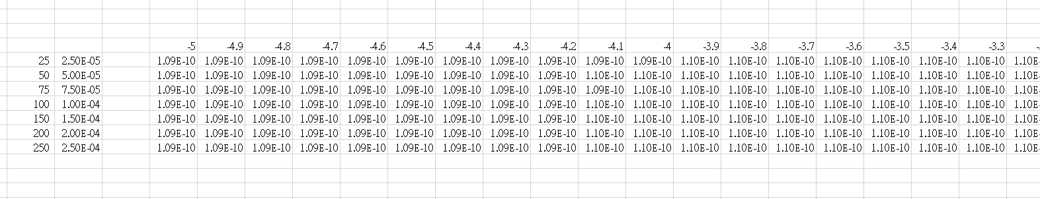
Group 1
定值Z
Group 1 XY轉置
1.Group 1 XY轉置

Slide 3
*1E-6
Group 1 XY轉置

Slide 4
*1E-6
定值X
Group 1 XY轉置
變數Y¹
變數Y² ……..
變數Y^{n}
(X,Y^{n},Z)
C₀
Slope = C₁
2.(X,Y^{n})做線性回歸
Y^{n}
X

Slide 5
3.參數計算
Z= -5~0
(X, Y¹, Z, C, C₀)
(X, Y¹, Z, N_{DL}, d)
C₀³
N_{DL}
C₁
d
C₀
q(基本電荷)=1.60217663 × 10⁻¹⁹ C
ε₀ (真空電容率) = 8.854 187 817× 10⁻¹² F/m
ε_{S} = 11.9
A= 1 × 10⁻³ m²

